Slide 1
A Deep Dive into COVID-19 Death Trends in the USA
Shibbir ahmed arif
MS – Data Science

Slide 2
Project Outline
Data Collection
Data Load
Data Exploration
Data Cleaning
Data Analysis
Map Visualization
Aggregation Visualization
Interactive Visualization
Conclusion

Slide 3
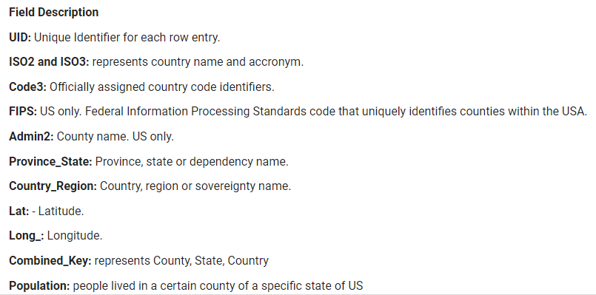
Data Collection
This is a daily reports based CSSE COVID-19 dataset published by John Hopkins University. This dataset contains daily death cases records between 2020 - 2023.
Data Source: https://github.com/CSSEGISandData/COVID-19/tree/master/csse_covid_19_data/csse_covid_19_daily_reports_us

Slide 4
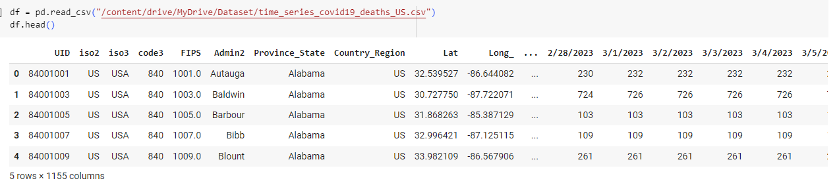
Data Load

Slide 5
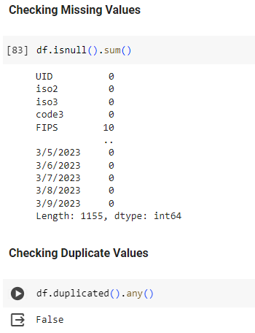
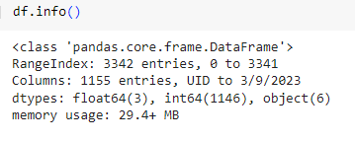
Data Exploration
Data Shape: 3342 rows and 1155 columns

Slide 6
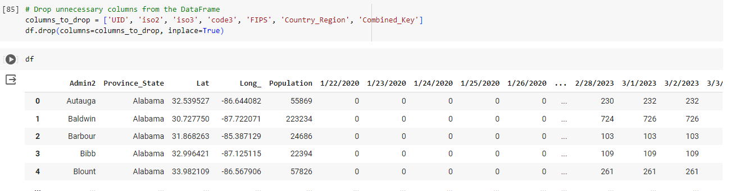
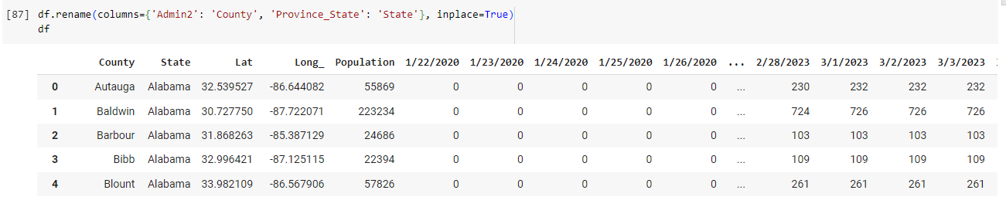
Data Cleaning

Slide 7
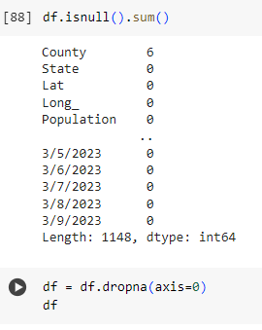
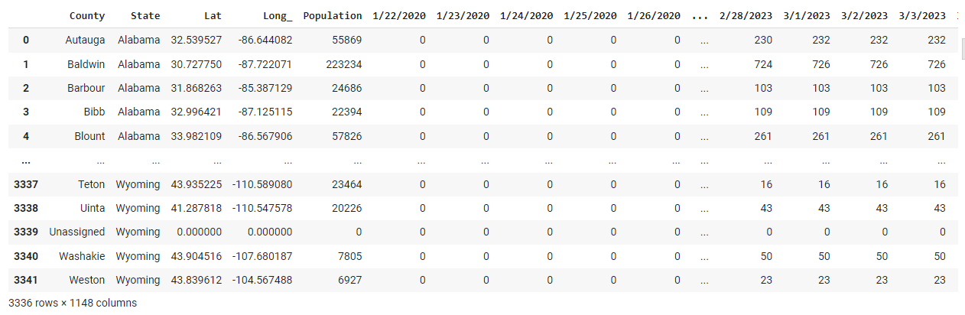
Data Cleaning – Cont.

Slide 8
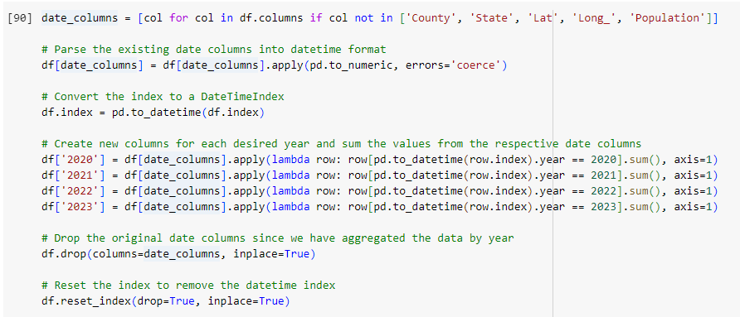
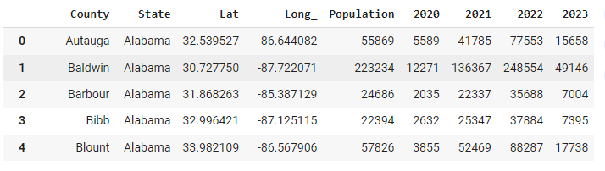
Data Wrangling

Slide 9
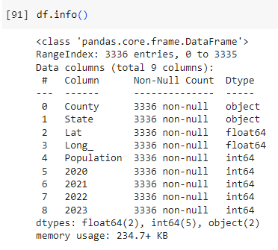
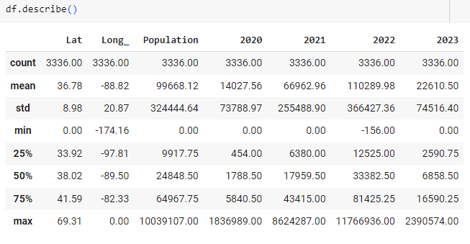
Descriptive Statistics

Slide 10
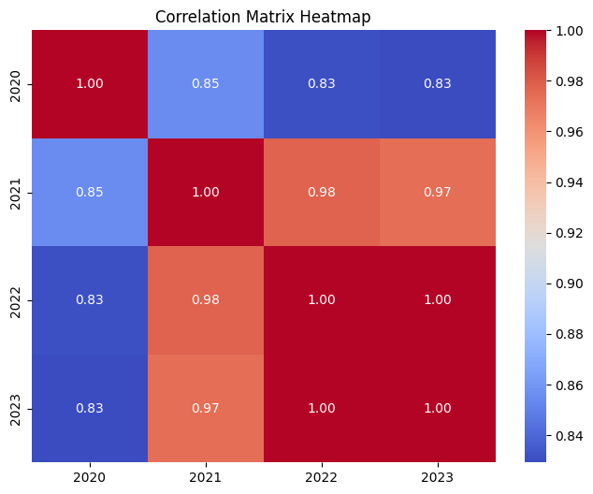
Correlation Matrix

Slide 11
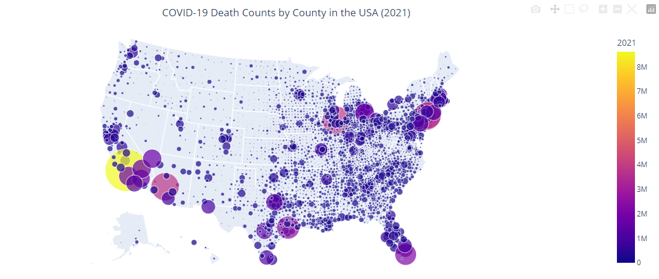
Interactive Map Visualization 1
Question: How do COVID-19 death counts vary across different counties in the USA in 2021?

Slide 12
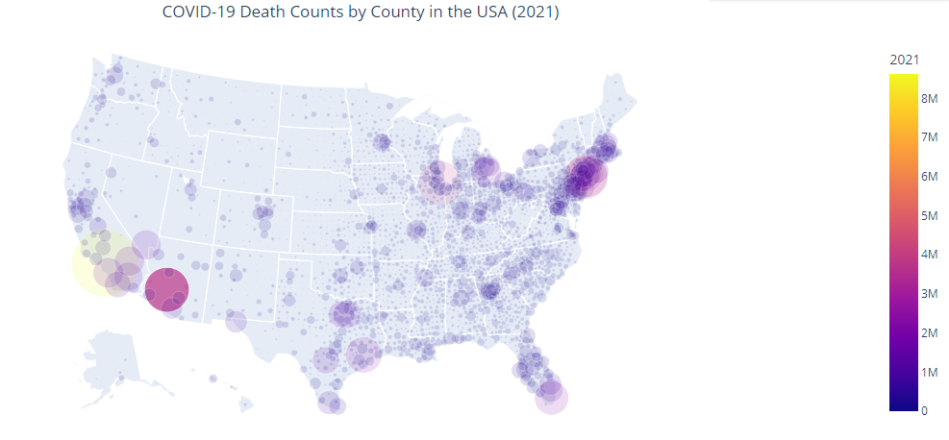
Continue
Each county is represented by a bubble on the map, where the size and color of the bubble indicate the death count for that county. This visualization provides a clear understanding of the distribution of COVID-19 fatalities across different counties in the USA during the year 2021.

Slide 13
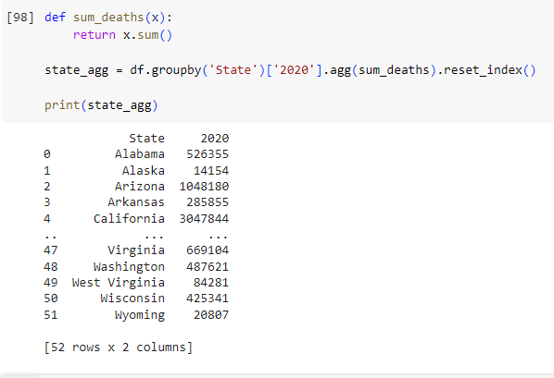
Interactive Aggregation Visualization 1
Question: How many people died in 2020 in each state?

Slide 14
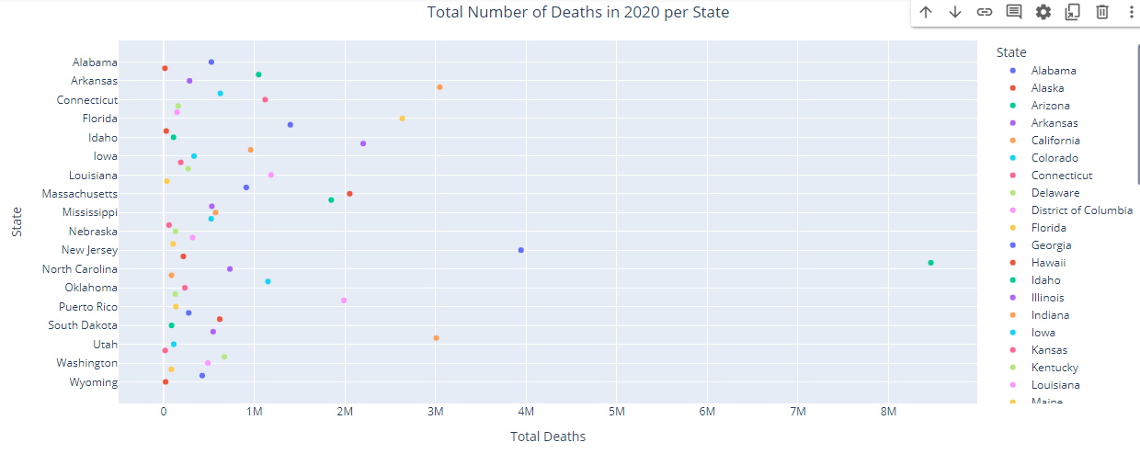
Continue
From this figure, we see that most number of people died in 2020 in the state of New York, New Jersey, California and Texas.

Slide 15
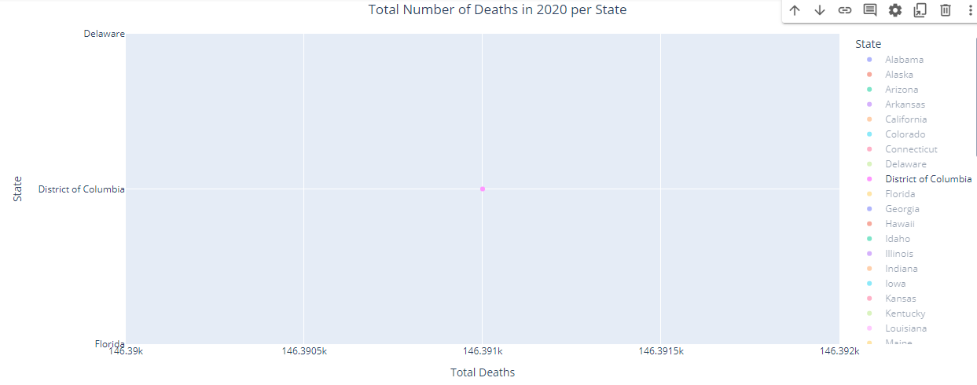
Continue

Slide 16
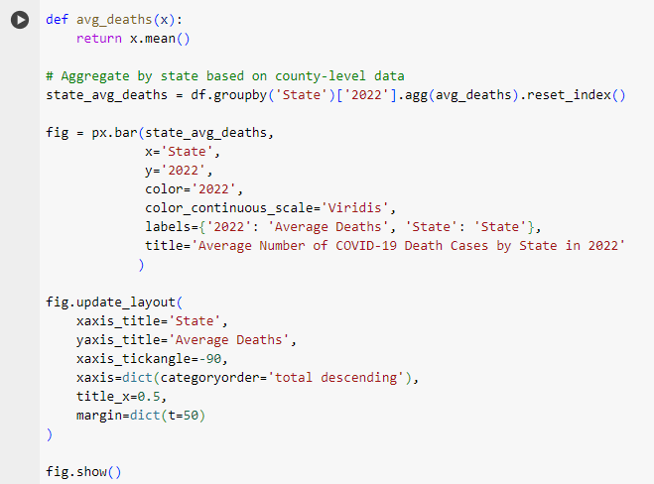
Aggregation Visualization 2
Question: What is the average number of COVID-19 deaths cases per US State in 2022?

Slide 17
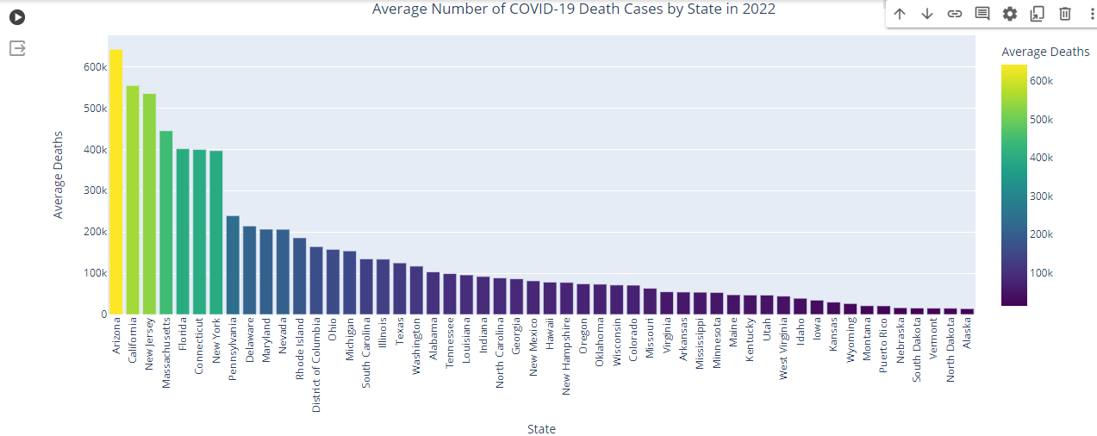
Continue
From the figure, we see that the highest average number of COVID-19 deaths cases in 2022 are in the state of Arizona, California, New Jersey.

Slide 18
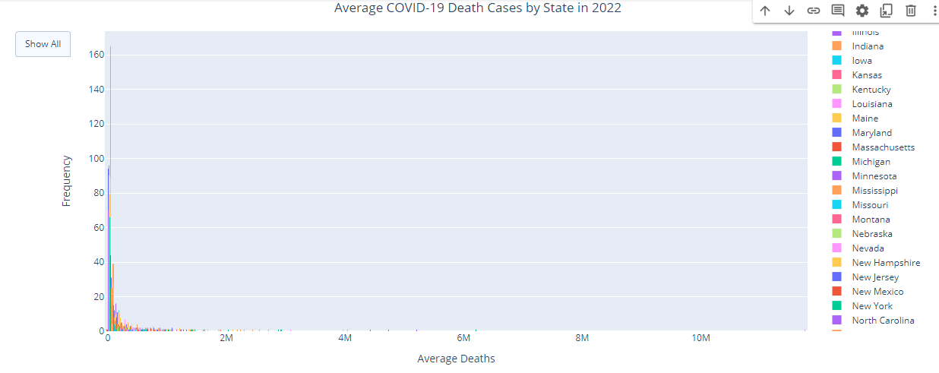
Interactive Visualization 3

Slide 19
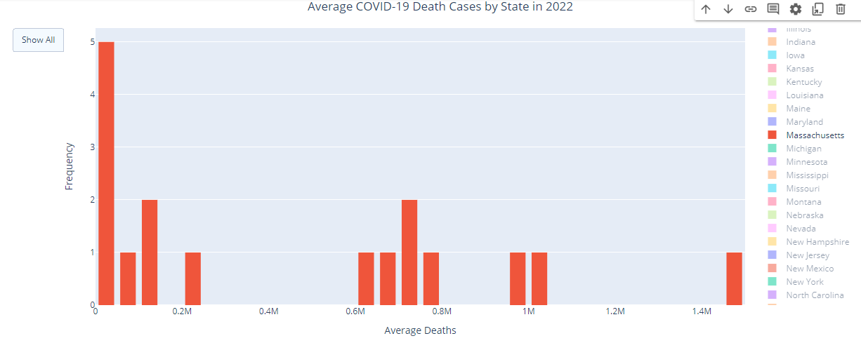
Continue
After double clicking on any state, we see that each bar in the histogram represents the distribution of average COVID-19 deaths cases across counties for that specific state.

Slide 20
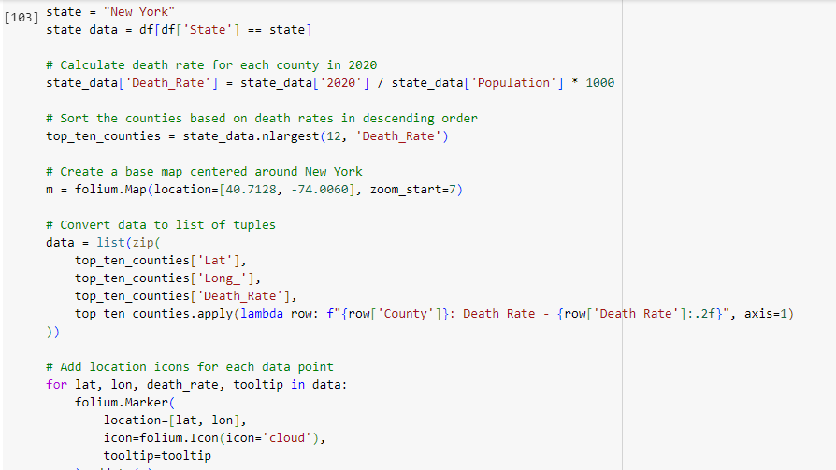
Map Visualization 2
Question: Find top ten counties of a particular state having the highest death rates in 2020?

Slide 21
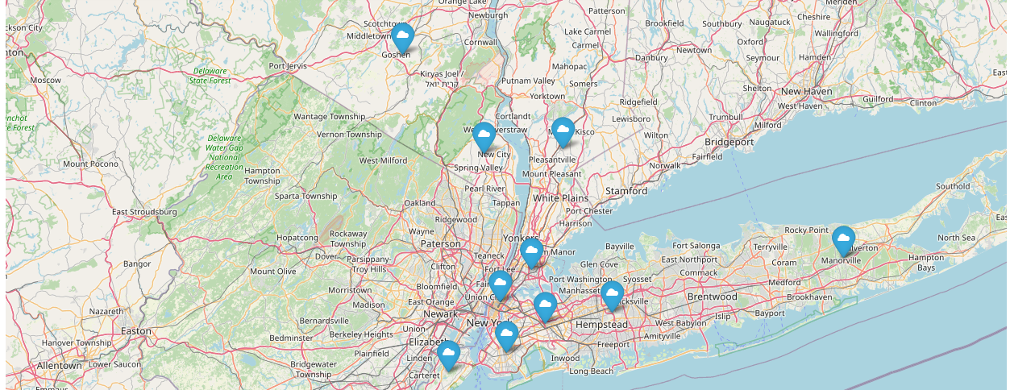
Continue
In this map, we can see that the map shows top 10 counties of New York state having highest covid19 death rates in 2020

Slide 22
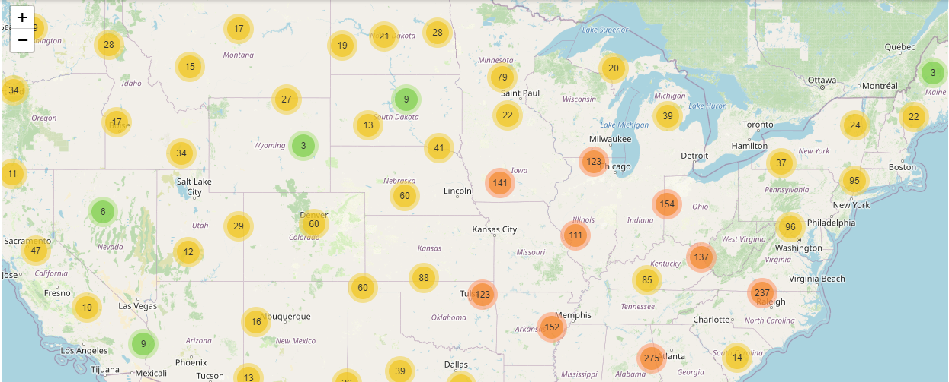
Interactive Visualization 4
Question: What is the number of death cases per city in each state?

Slide 23
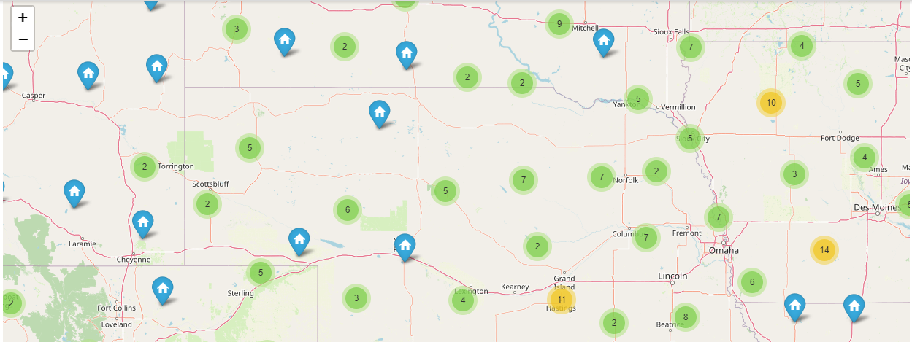
Continue
From this map, if we click on any state then we can see the number of death cases of different cities for that state

Slide 24
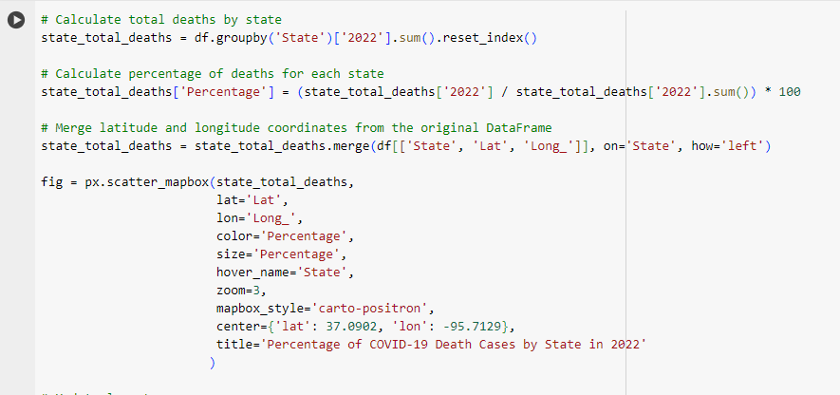
Map Visualization 3
Question: What is the percentage of deaths for each state in a specific year?

Slide 25
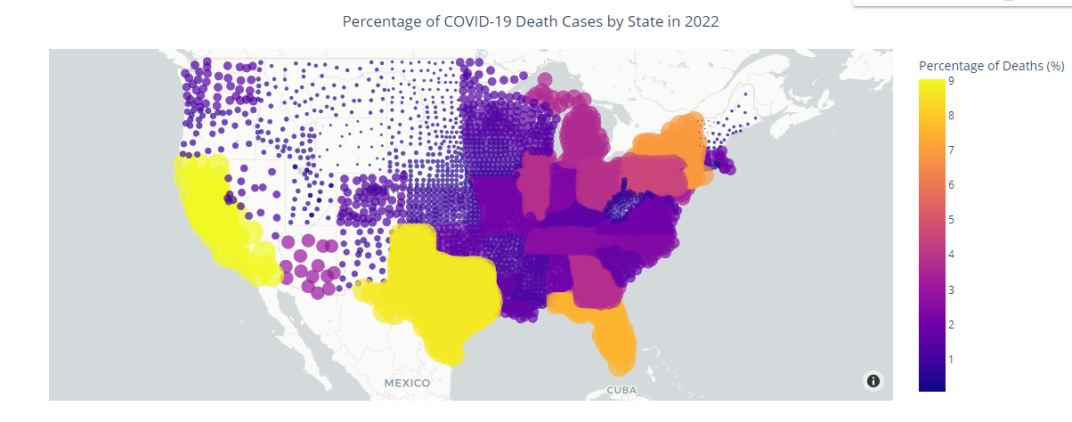
Continue
We can see the percentage of COVID-19 death cases by state in 2022 in this figure.

Slide 26
Conclusion
COVID-19 death counts varied significantly across US counties in 2021 due to factors like
population density and healthcare infrastructure.
In 2020, COVID-19 deaths varied by state, reflecting differences in virus spread and public
health responses.
The average number of COVID-19 deaths per US state in 2022 indicates ongoing pandemic
impact.
Top ten counties within a state with highest death rates in 2020 faced challenges in
containment efforts.
Analyzing death cases per city within each state offers insights into localized transmission
patterns.
Calculating the percentage of deaths for each state in a specific year informs resource allocation
and targeted interventions.

Slide 27
Thank You

